Slide 1

A Machine learning Architecture Design
-:Anjali Meena(18114076)

Slide 2
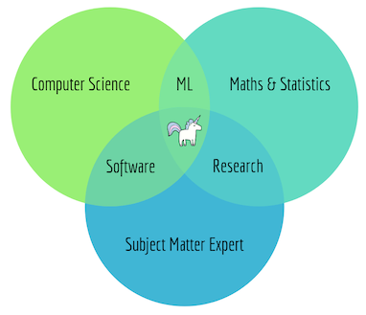
I Introduction
As we have seen before in the famous Venn diagram of Steven
Geringer, Data Science is the intersection of 3 disciplines:
Computer Science, Mathematics/Statistics and a particular
Domain knowledge.

Slide 3
The main objectives are to build a system that :
Reduces latency;
Is integrated but loosely coupled with the other parts of the system, e.g. data stores, reporting, graphical user interface;
Can scale both horizontally and vertically;
Is message driven i.e. the system communicates via asynchronous, non-blocking message passing;
▸ Provides efficient computation with regards to workload management;
▸ Is fault-tolerant and self healing i.e. breakdown management;
▸ Supports batch and real-time processing.

Slide 4
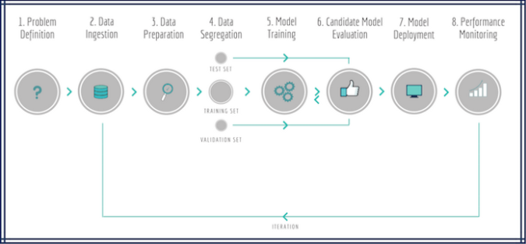
ML Pipeline ...

Slide 5
Architecting a ML Pipeline
Traditionally, pipelines involve overnight batch processing, i.e. collecting data, sending it through an enterprise message bus and processing it to provide pre-calculated results and guidance for next day’s operations. Whilst this works in some industries, it is really insufficient in others, and especially when it comes to ML applications.
The following diagram shows a ML pipeline applied to a real-time business problem where features and predictions are time sensitive (e.g. Netflix’s recommendation engines, Uber’s arrival time estimation, LinkedIn’s connections suggestions, Airbnb’s search engines etc).

Slide 6
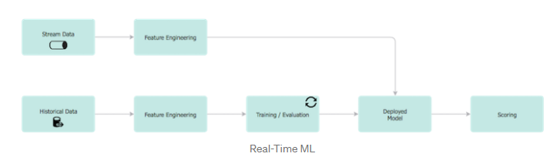
It comprises of two clearly defined components:
Online Model Analytics: The top row represents the operational component of the application i.e. where the model is applied for real-time decision making.
Offline Data Discovery: The bottom row represents the learning component i.e. analysis on historical data to create the ML model in a batch-processing mode.
We will now take this simplified diagram and unfold its inner workings.

Slide 7
Data Ingestion
1
Funnelling incoming data into a data store is the first step of any ML workflow. The key point is that data is persisted without undertaking any transformation at all, to allow us to have an immutable record of the original dataset. Data can be fed from various data sources; either obtained by request (pub/sub) or streamed from other services

Slide 8
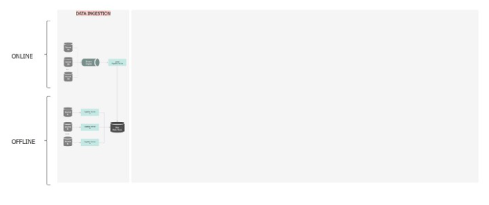
NoSQL document databases are ideal for storing large volumes of rapidly changing structured and/or unstructured data, since they are schema-less. They also offer a distributed, scalable, replicated data storage.

Slide 9
OFFLINE
In the offline layer, data flows into the Raw Data Store via an Ingestion Service — a composite orchestration service, which encapsulates the data sourcing and persistence. Internally, a repository pattern is employed to interact with a data service, which in return interacts with the data store. When the data is saved in the database, a unique batch-id is assigned to the dataset, to allow for efficient querying and end-to-end data lineage and traceability.
To be performant, the ingestion distribution is twofold:
• there is a dedicated pipeline for each dataset so all of them are processed independently and concurrently, and
• within each pipeline, the data is partitioned to take advantage of the multiple server cores, processors or even servers.

Slide 10
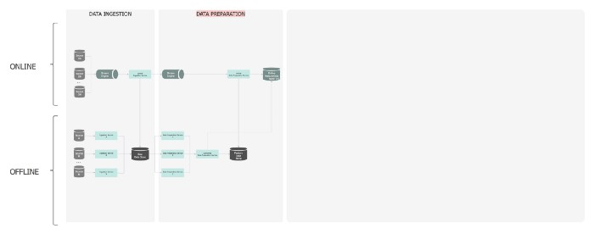
Data Preparation
Data exploration, data transformation and feature engineering

Slide 11
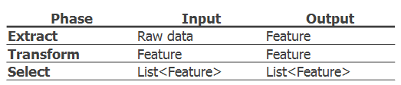
Once the data is ingested, a distributed pipeline is generated which assesses the condition of the data, i.e. looks for format differences, outliers, trends, incorrect, missing, or skewed data and rectify any anomalies along the way. This step also includes the feature engineering process. There are three main phases in a feature pipeline: extraction, transformation and selection.
Both feature extractors and
transformers should structured with composition and re-usability in mind.
Selecting the features can be left to the caller, or can be automated

Slide 12
OFFLINE
In the offline layer, the Data Preparation Service, is triggered by the completion of the ingestion service. It sources the Raw Data, undertakes all the feature engineering logic, and saves the generated features in the Feature Data Store.
Optionally, the features from multiple data sources can be combined, so a ‘join/sync’ task is designed to aggregate all the intermediate completion events and create these new, combined features. In the end, the notification service broadcasts to the broker this process is complete and the features are available.
When each data preparation pipeline ﬁnishes, the features are also replicated to the Online Feature Data Store, so that the features can be queried with low latency for real-time prediction.

Slide 13
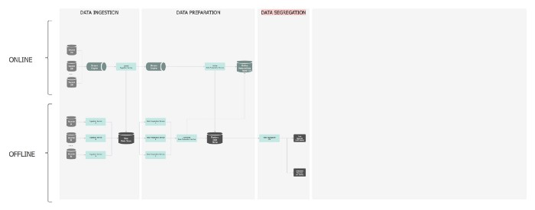
Data Segregation
Split subsets of data to train the model and further validate how it performs against new data.

Slide 14
The fundamental goal of the ML system is to use an accurate model based on the quality of its pattern prediction for data that it has not been trained on. As such, existing labelled data is used as a proxy for future/unseen data, by splitting it into training and evaluation subsets.
There are many strategies to do that, four of the most common ones are:
Use a default or custom ratio to split it into the two subsets, sequentially i.e. in the order it appears in the source, making sure there is no overlapping. For instance use the first 70% of data for training and the subsequent 30% of data for testing.
Use a default or custom ratio to split it into the two subsets via a random seed. For instance select a random 70% of the source data for training and the complement of this random subset for testing.

Slide 15
• Use either of the methods above (sequential vs. random) but also shuffle the records within each dataset.
• Use a custom injected strategy to split the data, when an explicit control over the separation is needed.
To protect the caller from specifying parameters that cause an uneven data distribution, a warning should be raised and returned along with the dataset.

Slide 16
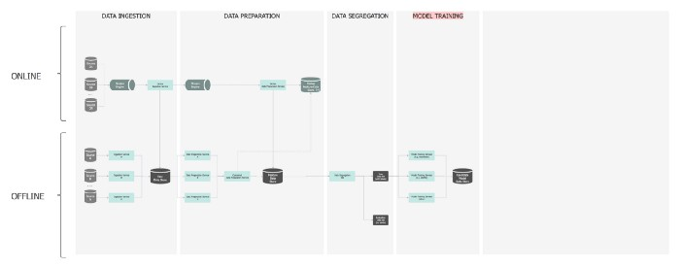
Model training
Use the training subset of data to let the ML algorithm recognise the patterns in it.

Slide 17
The model training pipeline is offline only and its schedule varies depending on the criticality of the application, from every couple of hours to once a day. Apart from schedulers, the service is also time and event triggered.
It consists of a library of training model algorithms (linear regression, ARIMA, k-means, decision trees etc), which is built in a SOLID way to make provision for continuous development of new model types as well as making them interchangeable. Also containment, using the facade pattern, is a crucial technique for integrating third-party APIs .
Model training must be implemented with error tolerance in mind and also data checkpoints and failover on training partitions should be enabled — e.g. each partition can be retrained if the previous attempt fails due to some transient issue (e.g. timeout).

Slide 18
There are a few options for parallelisation:
• The simplest form is to have a dedicated pipeline for each model, i.e. all models run concurrently.
• Another idea is to parallelise the training data i.e. the data is partitioned and each partition has a replica of the model. This is preferred for those models that they need all fields of an instance to perform the computation (e.g. LDA, MF).
• A third option is to parallelise the model itself i.e. the model is partitioned and each partition is responsible for the updates of a portion of parameters. It is ideal for Linear models, such as LR, SVM.
• Finally, a hybrid approach can be used, combining one or more options.

Slide 19
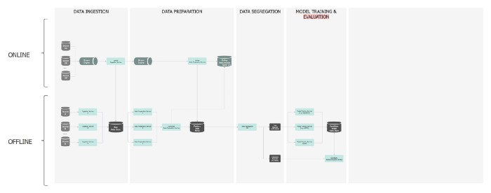
Candidate Model Evaluation
Assess the performance of the model using the test subset of data to understand how accurate the prediction is.

Slide 20
This pipeline is also offline. The predictive performance of a model is evaluated by comparing predictions on the evaluation dataset with true values using a variety of metrics.
The “best” model on the evaluation subset is selected to make predictions on future/new instances.
A library of several evaluators is designed to provide a model’s accuracy metrics (e.g. ROC curve, PR curve), which are also saved against the model in the data store.
Again, same patterns are applicable here to allow flexibility on combining and switching between evaluators.

Slide 21
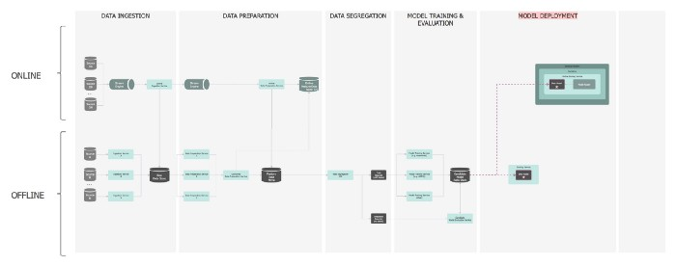
Model Development
Once the chosen model is produced, it is typically deployed and embedded in decision-making frameworks.
Model deployment is not the end; it is just the beginning!

Slide 22
The best model selected is deployed for offline (asynchronous) and online (synchronous) predictions. More than one models can be deployed at any time to enable safe transition between old and new models — i.e. when deploying a new model, the services need to keep serving prediction requests.
Traditionally, a challenge in deployment has been that the programming languages needed to operationalise models have been different from those that have been used to develop them. Porting a Python or R model into a production language like C++, C# or Java is challenging, and often results in reduced performance (speed & accuracy) of the original model. There are a few ways to address this issue. In no particular order:

Slide 23
Rewrite the code in the new language [i.e. translate from Python to CSharp]
• Create custom DSL (Domain Specific Language) to describe the model
• Microservice (accessed through a RESTful API)
• API-first approach
• Containerisation
• Serialise the model and load into a in-memory key-value store

Slide 24
Offline
• In an offline mode, the prediction model can be deployed to a container and run as a microservice to create predictions on demand or on a periodic schedule.
• A different choice is to create a wrapper around it so you gain control over the functions available. Once a batch prediction request is made, you can load it dynamically into memory as a separate process, call the prediction functions, unload it from memory and free up the resources (native handles).
• Finally another approach is to wrap the library into an API and let the caller invoke it directly or wrap it around their service to fully take over the reins of the prediction instrumentation.
In terms of scalability, multiple parallel pipelines can be created to accommodate the load. This involves inconsiderable effort, as the ML models are stateless.

Slide 25
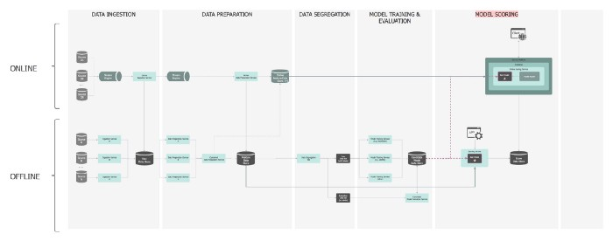
Model Scoring
Process of applying a ML model to a new dataset in order to uncover practical insights that will help solve a business problem. A.k.a. Model Serving.

Slide 26
Model Scoring is the process of generating new values, given a model and some new input. The generic term score is used, rather than prediction, as it may result in different types of values:
• A list of recommended items
• Numeric values, for time series models and regression models
• A probability value, indicating the likelihood that a new input belongs to some existing category
• The name of a category or cluster to which a new item is most similar
• A predicted class or outcome, for classification models.

Slide 27
Offline
In the offline layer, the Scoring Service is optimised for high throughput, fire-and-forget predictions for a large collection of data. An application can send an asynchronous request to kick off the scoring process, but needs to wait until the batch scoring process completes before it can access the prediction results. The service prepares the data, generates the features, but also fetches extra features from the Feature Data Store. Once scoring takes place, the results are saved in the Score Data Store. A message is sent to the broker to notify that the scoring has completed. The application is listening to this event and when notified it fetches the scores.

Slide 28
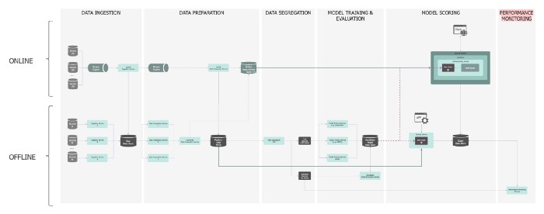
Performance Monitoring
The model is continuously monitored to observe how it behaved in the real world and calibrated accordingly.

Slide 29
Any ML solution requires a well-defined performance monitoring solution. An example of information that we might want to see for model serving applications includes:
• model identifier,
• deployment date/time,
• number of times the model has been served,
• average/min/max model serving times,
• distribution of features used.
• predicted vs. actual/observed results.

Slide 30
This metadata is calculated during the model scoring and then used for monitoring.
This is another offline pipeline. The Performance Monitoring Service, is notified when a new prediction is served, executes the performance evaluation, persists the results and the relevant notifications are raised. The evaluation itself takes place by comparing the scores to the observed outcomes generated by the data pipeline (training set). The basic implementation for monitoring can follow different approaches with the most popular being logging analytics (Kibana, Grafana, Splunk etc).
To ensure built-in resilience of the ML system, a poor speed performance of the new model triggers the scores to be generated by the previous model. A “better wrong than late” philosophy is adopted: if a term in the model takes too long to be computed, the model is substituted by a previously deployed model, rather than blocking.

Slide 31
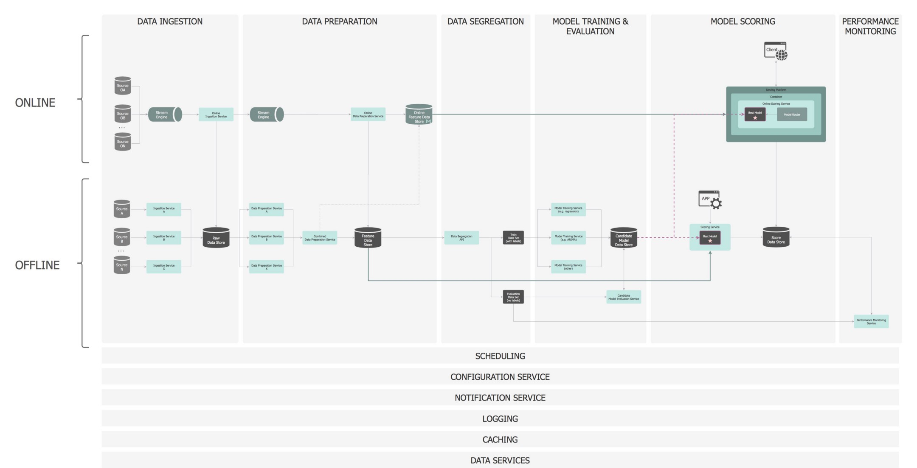
And Pull It all together
There you have it… A production ready ML system:

